Slide 1
WELCOME SLIGO WOMEN IN BUSINESS NETWORK
25 June 2024
hello@swibn.ie

Slide 2
Meeting plan
Welcome, grab some refreshments
Wellness: Celine Kilcoyne
Tech Tip: Network tech interaction
Europe Direct Sligo County Libraries
– Brenda Cawley
Networking: 1 to 1 and groups
What is next

Slide 3
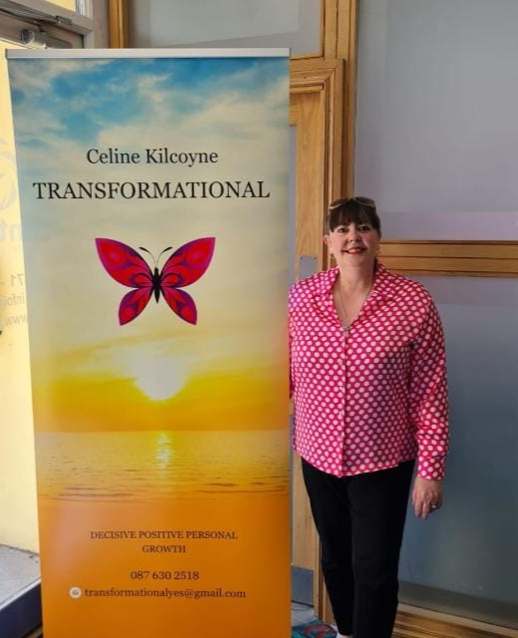
Wellness tips
Celine Kilcoyne
TRANSFORMATIONAL
Decisive Positive Personal Growth
transformationalyes@gmail.com

Slide 4
Meditation Ends All Suffering – Budda

Slide 5
https://youtu.be/gC2IZcxSPII

Slide 6
Networking
Tech interaction
Take time to pull up your social media
How to download Borrow Box

Slide 8
Networking
1 to 1
Rotate in 2 minutes
1 minute per person
Introduce yourself – who you are / what you do.
What is the your USP -
Unique Selling point?
Share socials / contact details and support.
Share Members Directory Listing
Support each other.

Slide 9
Networking
Group session
12 minutes
Next group
Introduce yourself – who you are / what you do.
Discuss what facilities are avail to me in Sligo and all over the county.
How will I use these?
Share socials / contact details and support.
Share Members Directory Listing
upport each other.

Slide 10
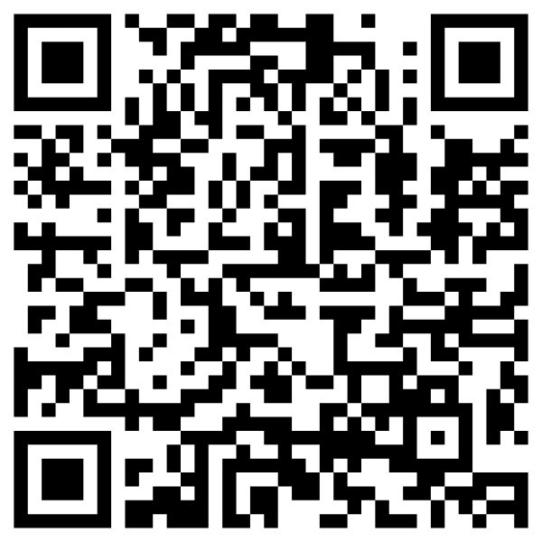
EVALUATION LINK
Junehttps://us14.list-manage.com/survey?u=c472b043cf73f5c2ecaa98461&id=2c1bd9fbc0&e=*|UNIQID|*
www.localenterprise.ie/Sligo
hello@SWIBN.Ie
www.SWIBN.ie

Slide 11
WHAT IS COMING UP
Register yourself on our Members Directory
Book on www.swibn.ie
Tuesday August 27 Networking event
7:00 - 8:30pm
Tuesday September 24
Networking event
9:30 - 11:00am
Thursday October 17
National Womens’
Enterprise Day
Evening event
Atlantic Technological University
ATU Sligo – Hume Hall
Refreshments, Speakers, Wellness and Networking
Hawk’s Well Theatre
– The Lobby
2 Temple St., Sligo, F91 CFY7
Refreshments and Networking
Juniper Barn
Newpark, Ballymote,
Co. Sligo F56 E033

