Slide 1
Dr. Valerie McTaggart Head of the Department Business

Slide 2
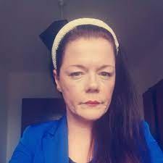
Dr. Valerie Mc Taggart Head of Department of Business ATU Sligo Research Expertise in Leading Digital Transformation, Business Process Reengineering, and Remote Working.

Slide 3
Is there anything that you are currently doing that you think you could do more efficiently
Activity

Slide 4
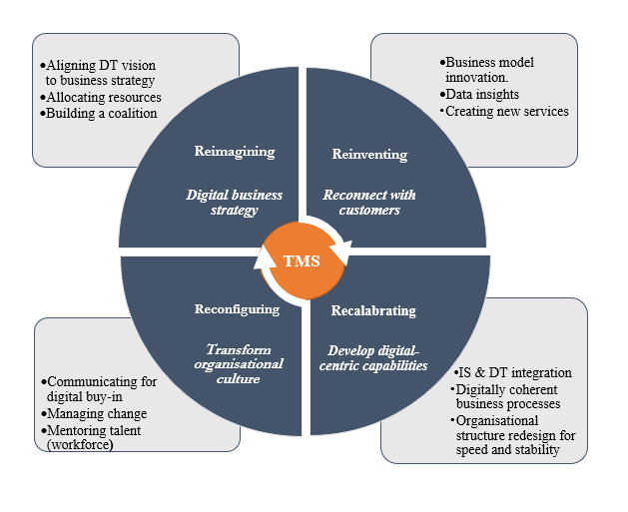
Four Factor Framework: How Top Management Supports a Digital Transformation
Reimagining a Digital Organisation
Reconfiguring for Change
Reinventing the Customer Experience
Recalibrating the Organization
V. McTaggart and J. Loonam, "Exploring Top Management Support for Digital Transformation: A Case Study of a European Financial Services Organization," in IEEE Transactions on Engineering Management, doi: 10.1109/TEM.2023.3299033.

Slide 5
Four-phase approach to supporting digital transformation Initiating Advancing Mobilising Deploying Mc Taggart & Loonam (2024) ‘How Top Management Support Digital Transformation”. IEEE Engineering Management Review (EMR). (Pending Publication)

Slide 6
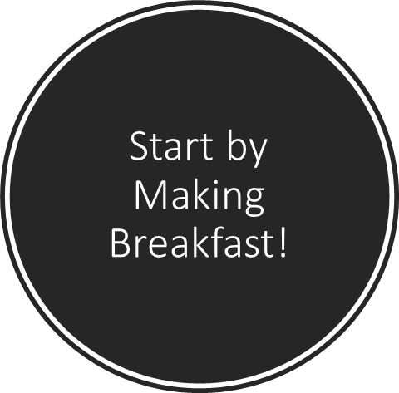

Slide 7
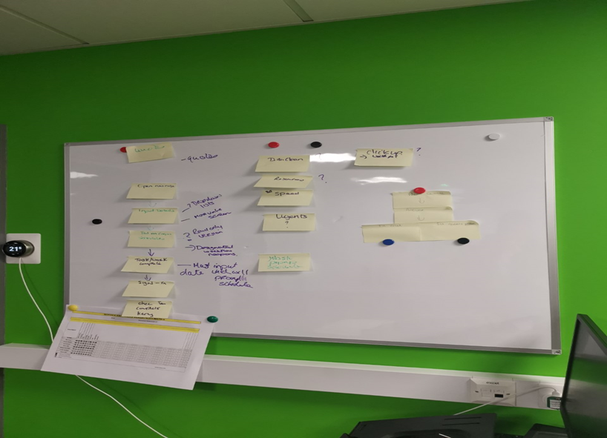
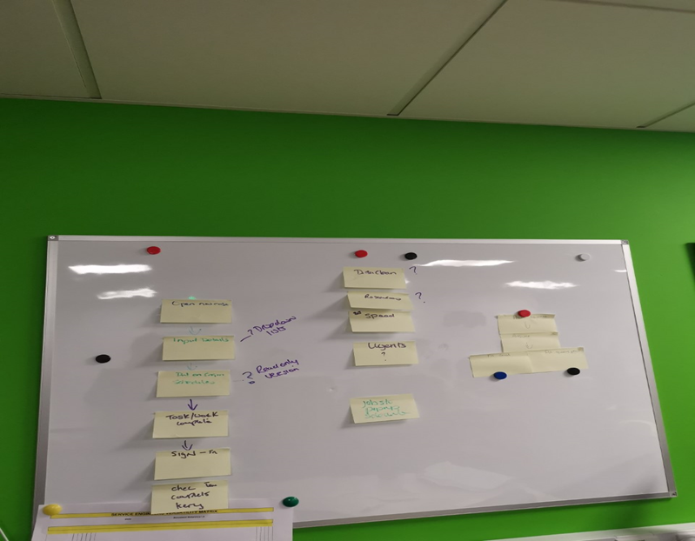
Process Mapping
In a Collaborative online Learning Environment mapped out the steps involved.

Slide 8
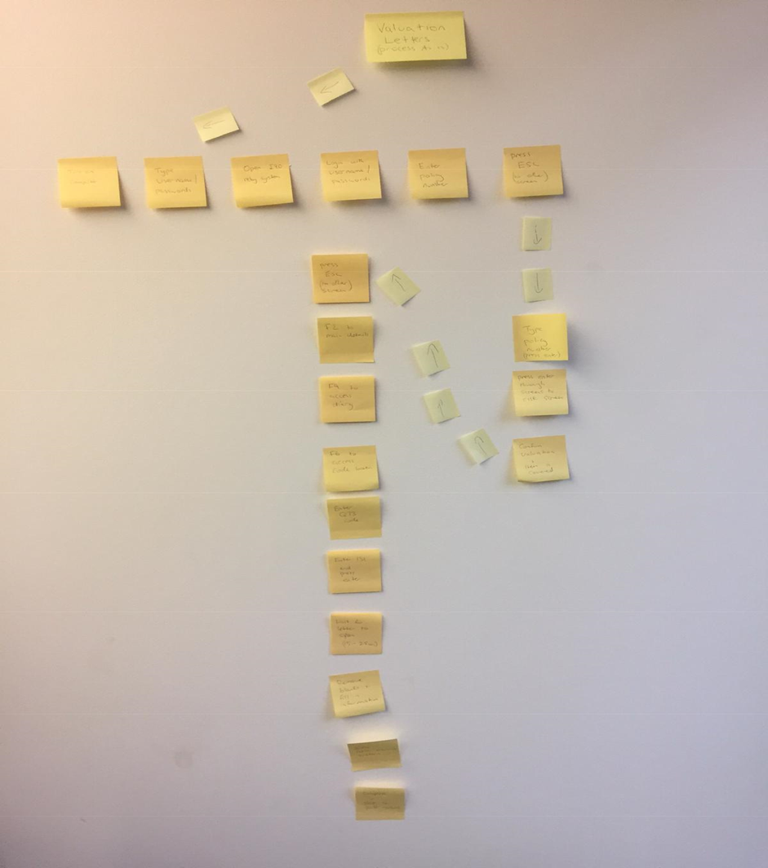
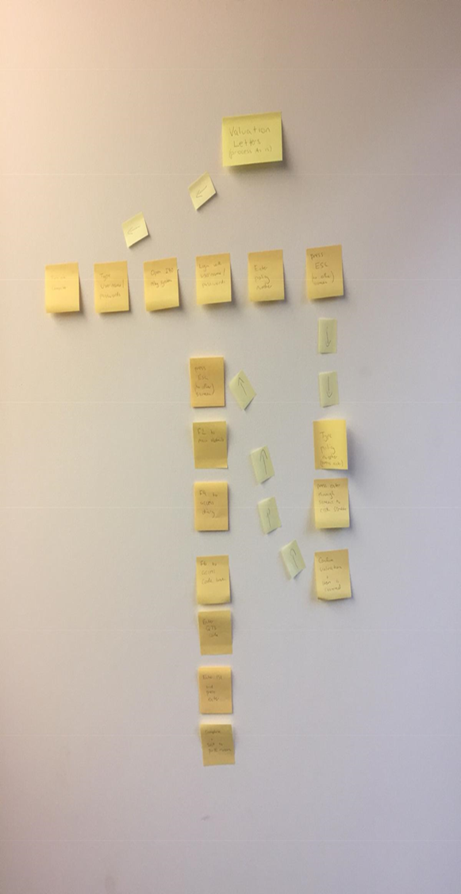
AS IS
TO BE

Slide 9
Process Map
Report

Slide 10
Project Implementation Plan

Slide 11
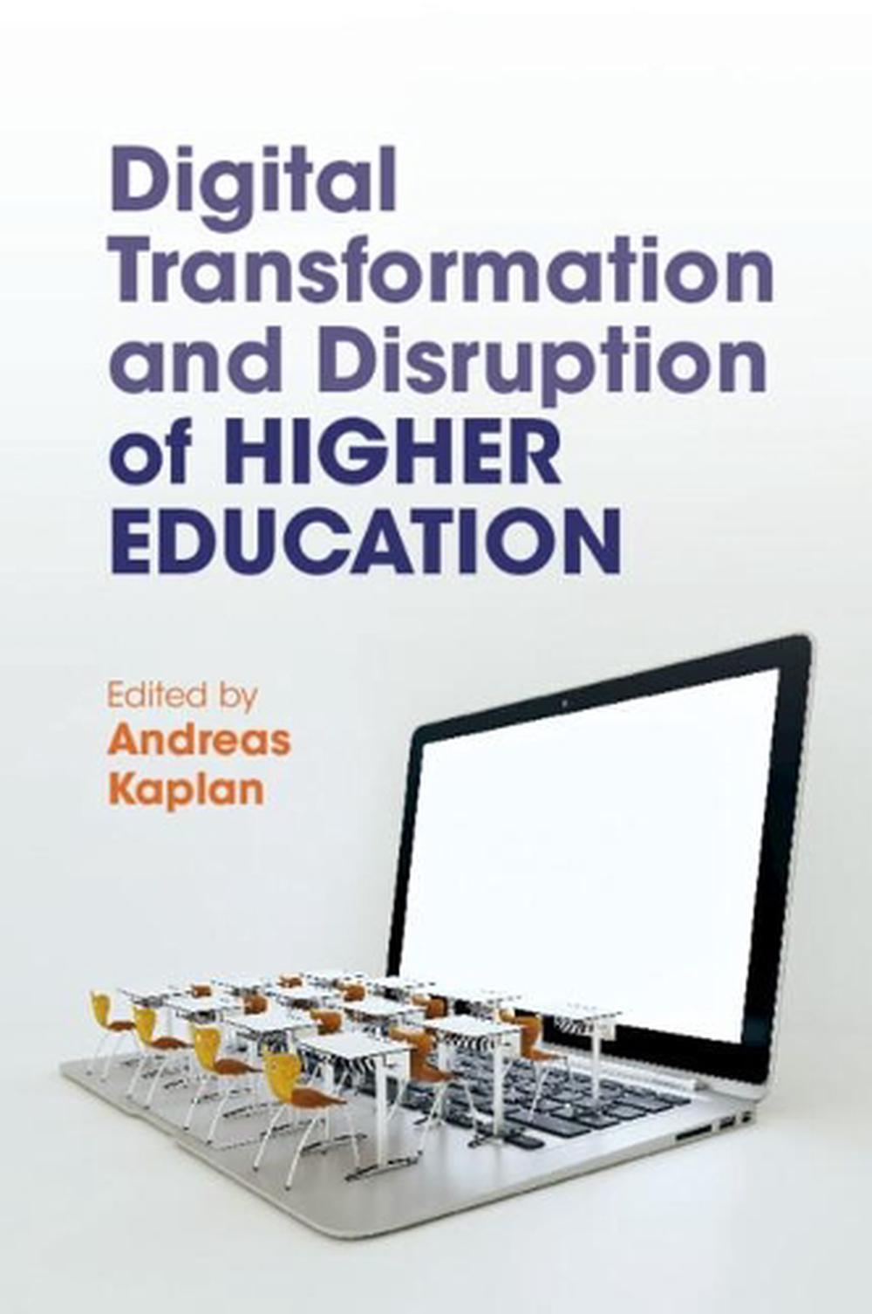
Combining Work Experience with Digital Learning
Kaplan,A. (2022) “Combining Work Experience with Digital Learning” Cambridge University Press ISBN: 9781108838900 (Chapter 13; McTaggart, V)

Slide 12
Can you combine your expertise with someone in SWINB to create a new business opportunity? Can you join with a colleague to undertake joint marketing initiatives? Can you share office space with complementary services, i.e. HR, finance, insurance
Entrepreneurial Ecosystem

Slide 13
What does the SWINB Ecosystem look like?

Slide 14
Community
Customers
Networks
Parent services
Retail Outlet
Hair and make up services
Pop up nail bar
Photography

Slide 15
The key is Mutually beneficial Everyone takes ownership
Finally

