Slide 1
Welcome Grab some lunch, Take a seat, Introduce yourself to someone new wifi: staysafe
27/06/2023
​​

Slide 2
Agenda
Lunch & informal networking
Welcome from SWIBN Co-Ordinators
Wellbeing Tip: Jahnvi Prajapati from Rangkalam - benefits of her art.
Tech tip
1 hour of intensive member networking
Feedback, close and what’s

Slide 3
Welcome from SWIBN co-ordinators Fran Best Maeve McCormack hello@swibn.ie

Slide 4
RANGKALAM
By
Jahnvi Prajapati from Rangkalam

Slide 5
HI, I'M JAHNVI
EXECUTIVE BRAND DIRECTOR
An Interior designer by profession, (Self taught)Artist by choice. I was indulged in art and craft since childhood, won multiple art competitions and judged a few too. Pandemic was when I took my passion for art more seriously and started my small business "RANGKALAM" (rang=colours, kalam=any tool used for art).Since then there was no looking back.

Slide 6
ABOUT 303THESTUDIO
303thestudio: A dynamic brand driven by the creative mind of an INDIAN Interior Designer with a deep passion for handmade art.
The brand offers a range of services, including Colour Consultancy, Art Parties, and Art Therapies.
Additionally, 303thestudio sells Texture Art, Fluid Art pieces, and Miniature Paintings.

Slide 7
WHAT IS WELLNESS ?

Slide 8
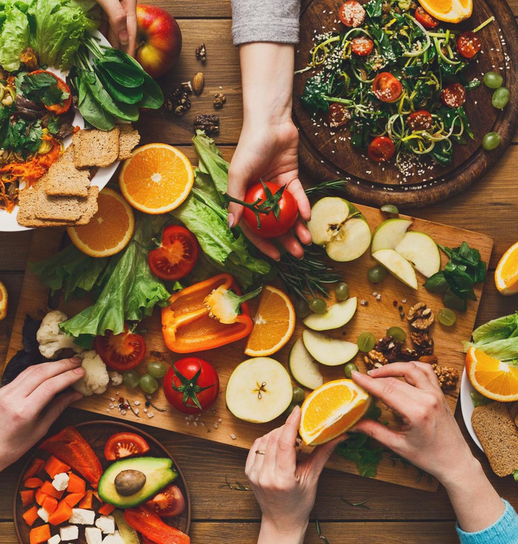
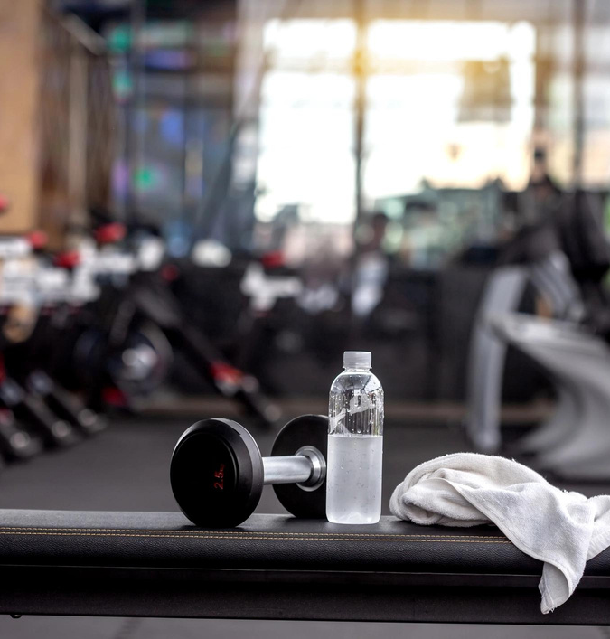
BUSTING MISCONCEPTION !
FANCY DIETS
GYMS
EXPENSIVE

Slide 9
THE
REALITY !
Ecological
Emotional
Spiritual
Financial
Wellness is the act of practicing healthy habits on a daily basis to attain better physical and mental health outcomes, so that instead of just surviving, you're thriving. Briefly it co-dependence dimensions. If any one of these dimensions is neglected over time, it will adversely affect one's health, well-being, & quality of life.
WELLNESS
Social
Intellectual
Physical
Occupational

Slide 10
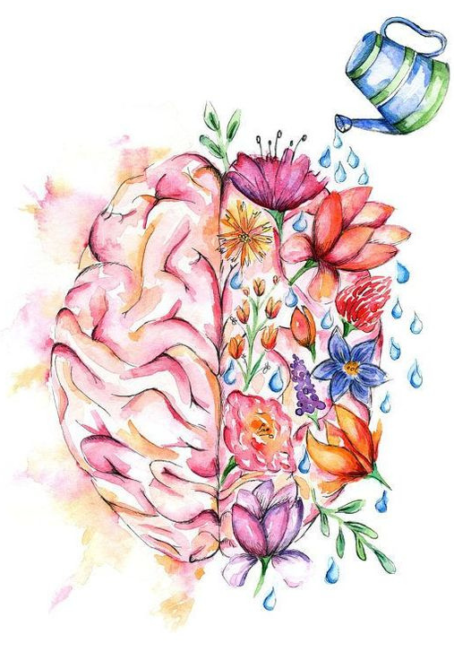
HOW WELLNESS INTEGRATED INTO ART ?
Emotional Expression & Release:
Art provides a safe and non-verbal outlet for expressing and releasing emotions.
Individuals can process and manage their emotions, promoting emotional well-being and healing
Stress Reduction & Relaxation:
Art activities can act as a form of relaxation and stress reduction.
Individuals focus their attention, calm their minds, and achieve a state of mindfulness
Self-Exploration & Personal Growth:
Artistic exploration encourages self-reflection and self-discovery.
Individuals can explore their identities, beliefs, and aspirations, fostering personal growth and self-awareness.

Slide 11
BENIFITS OF ART & WELLNESS INTEGRATION
ENHANCED MENTAL
HEALTH
IMPROVED SELF-ESTEEM
& SELF CONFIDENCE
INCREASED RESILIENCE

Slide 12
SERVICES WE PROVIDE
Art Parties
Art Therapies
Colour Consultancy
Host a unique and creative art party with 303theSTUDIO. Enjoy a fun-filled event with friends while exploring your artistic side.
Art therapy can help reduce stress, improve self-esteem, promote self-awareness, and enhance cognitive function. It's a powerful tool for healing and personal growth.
Colours have a powerful impact on our emotions and well-being. Our color consultants will help you choose colors mindfully and intentionally.

Slide 13
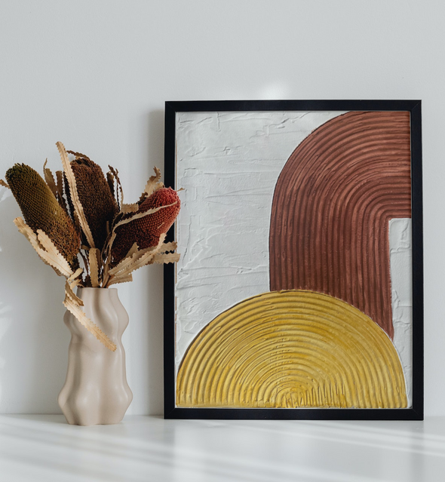
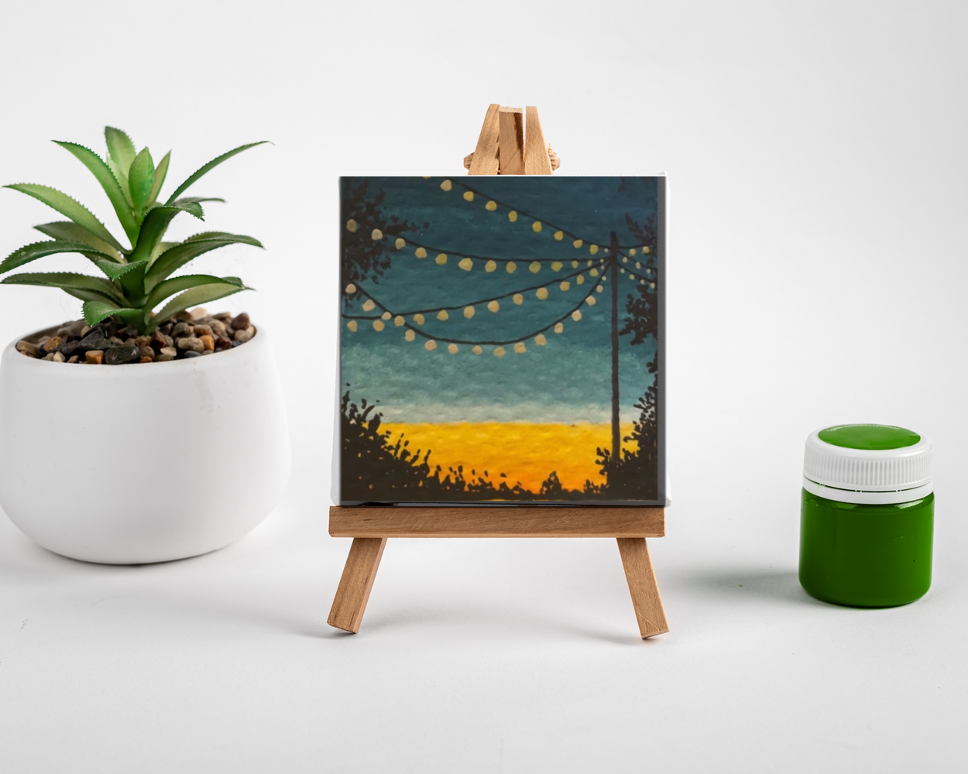
THE PRODUCTS
The art pieces sold by 303thestudio are carefully crafted to evoke positive emotions, relaxation, and joy. Each piece is infused with the founder's passion for art and her belief in the power of colors, textures, and forms to uplift and inspire.
Texture Art: Handcrafted pieces that add depth, texture, and visual interest to any space.
Fluid Art: Stunning artworks created through the mesmerizing flow of colors and textures.
Miniature Paintings: Intricate and captivating artworks that showcase meticulous details and craftsmanship.

Slide 14
SOCIAL MEDIA
Visit Our Social Media
Get a better insight into our brand, services, and the
products we offer through our social media.
085 119 2403
303thestudio.square.site
303thestudio

Slide 15
THANK YOU
Looking Forward To Work Together !

Slide 16
Tech tip – Chat GPT 3.5, free tool www.chat.openai.com

Slide 17
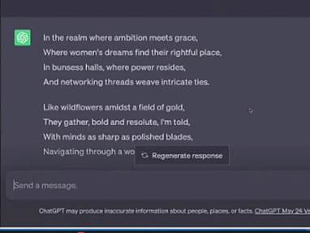
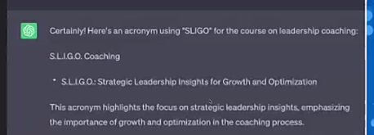
Tech tip – Chat GPT 3.5, free tool www.chat.openai.com

Slide 18
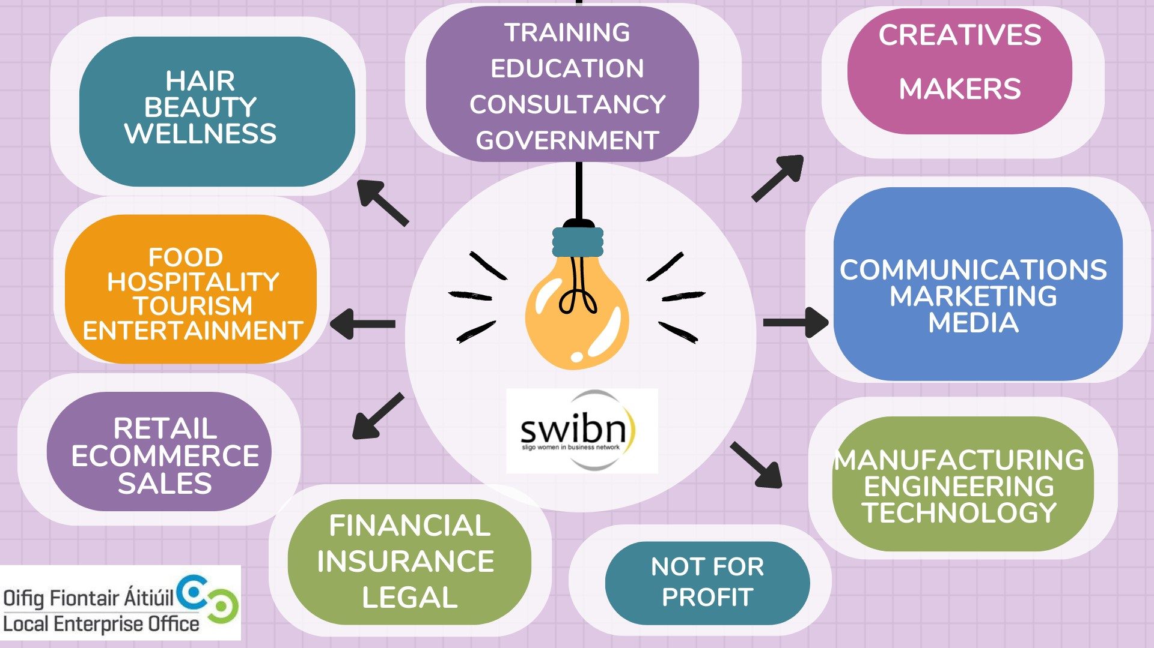

Slide 19
Focused networking – like minded groups
Name. What your business does
1.What solution have you” come up with” to overcome an obstacle that you have faced?.
2. What useful support: funding, training have you used that you would recommend.
3. What makes you unique to your competition?
How can you support one another - Don’t forget to share contact details.

Slide 20
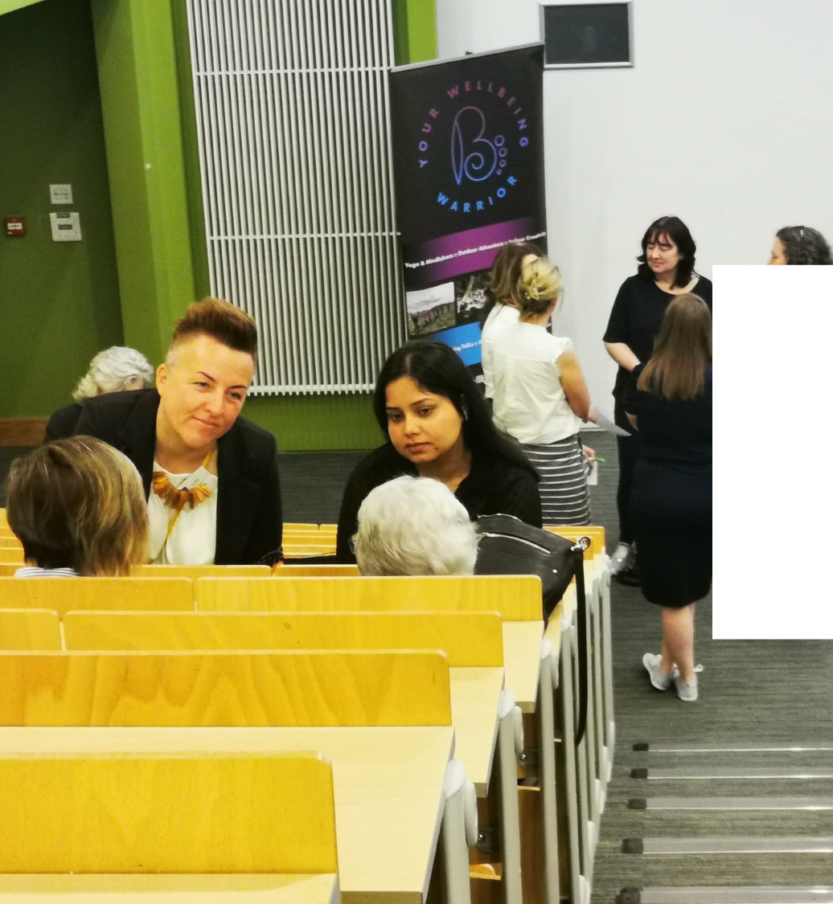
Thank you
from Fran & Maeve
July – Summer break​
August 29 – 7pm Summer social outing
Sept 26 – 9:30am The Model – Social media
NWED Oct 19 – 5-9pm Lough Eske Castle
Connect and support
Contact Shona – LEO Sligo for training, mentoring, funding questions.

Slide 21
​
Network, promote and interact
with each another online
www.swibn.ie
​

Slide 22
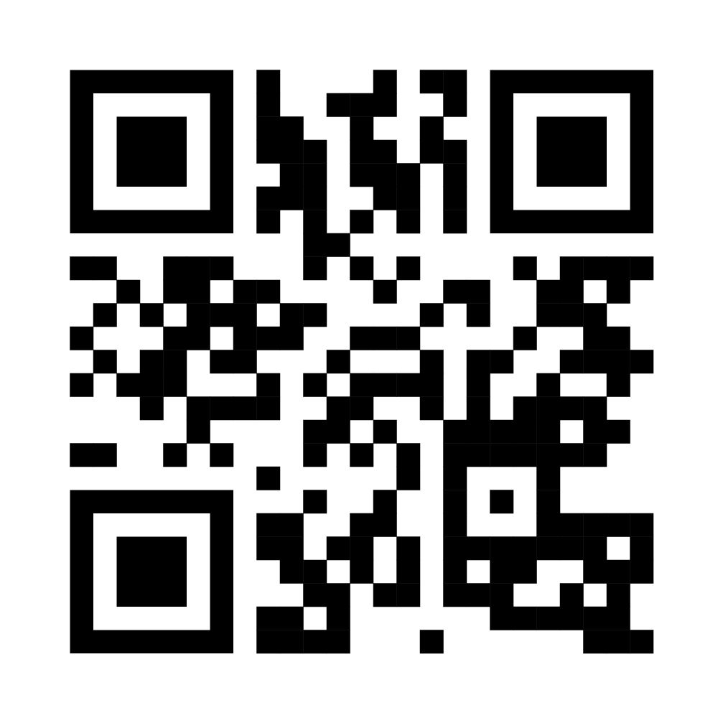
​
Camera – Link – LinkedIn
​

